Slide 1
Data visualizations for usual intakes
PHAC Health Infobase
Presentation to FNSS WG
March 11, 2020

Slide 2
Outline:
What is the Public Health Infobase?
Review tools being developed to visualize usual intake data (phase 1)
Review planned future visualizations (phase 2)

Slide 3
What is the Public Health Infobase ?
A series of Internet based tools to help visualize, analyze, interpret and disseminate health indicator data for chronic disease, injury and child/maternal health
Surveillance and Epidemiology Division, Centre for Surveillance and Applied Research, Health Promotion and Chronic Disease Prevention Branch, PHAC
https://health-infobase.canada.ca/

Slide 4
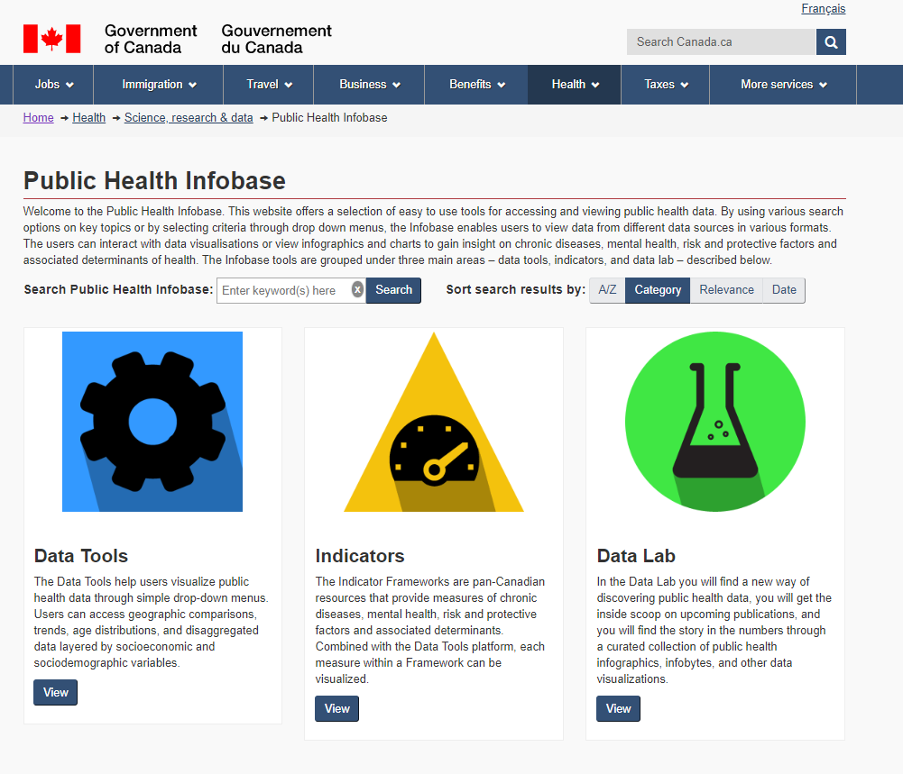

Slide 5


Slide 6
Phase 1: Usual intakes from food
Objective: Complement the usual intake from food dataset (“Compendium”) to be posted on Open Data with interactive and user-friendly data visualizations.

Slide 7
Tool #1: Customizable table
Allows users to create a custom table based on parameters and data elements of interest from Compendium dataset:
  Nutrient
  Region
  Age-sex group
  Mean
  Percentiles
  DRI comparison(s) (i.e. % <EAR)

Slide 8
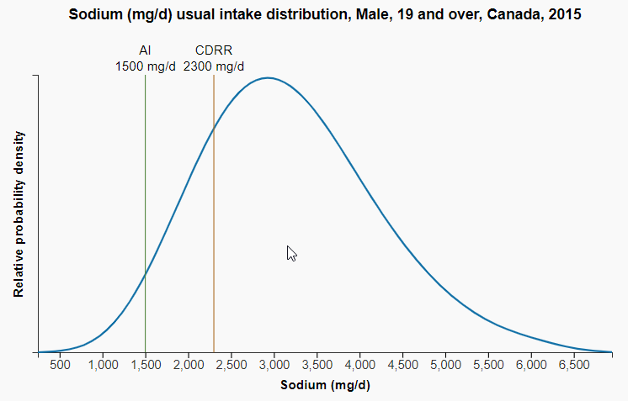
Tool #2: Usual intake distribution curves
Usual intake distribution curves
  National level
  Age-sex groups: all 16 from compendium
  Nutrients: Core nutrient on NFT, any nutrient with a DRI

Slide 9
Tools #3: Geographic comparison
Geographic comparison for inadequate/excessive intakes
  Provincial estimates
  Adults 19+, Males and Females (separately and combined)
  Nutrients: Those with DRI

Slide 10
What to include in footnotes?
Data source, abbreviation definitions, STC notes (E, F, <3), link to reference guide & methodology guide
Relative probability density estimates were generated from the percentiles of usual intake data set using a Gaussian Kernel density estimation method.
Statement about reliability of the tails?

Slide 11
Ideas for future visualizations
Adding total usual intake distribution curve
Top food sources of nutrients of public health concern

Slide 12
  We can put a lot of data on the web:
  Who is the audience / who do you want to reach ?
  What information do you want them to reach ?

